Slide 1


Traffic Sign
Detection & Recognition
Group Members
樊斯特 12111624
肖佳辰 12112012

Slide 2


Contents
01
/ Introduction
02
/ Related Works
03
/ Methodology
04
/ Scheduling
Problem Formulation
Project Overview
Novelty and Difficulty
TSR-YOLO for YOLOv4
YOLOv8
Data Preprocessing
Model Training
Model Improving
Current Progress
Timeline

Slide 3
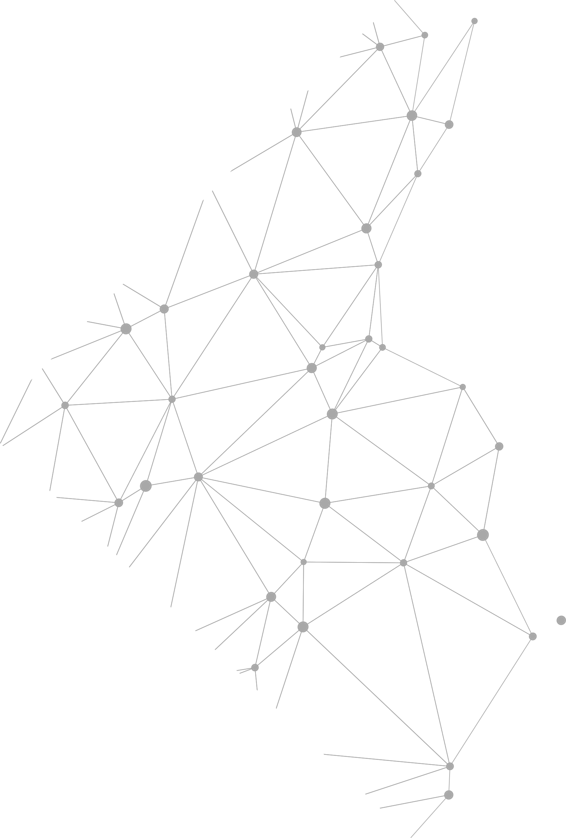

01
Introduction

Slide 4
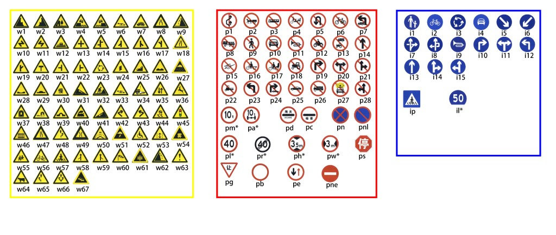
Problem Formulation
Dataset: TT1000K[1]
https://cg.cs.tsinghua.edu.cn/traffic-sign/
[1]Z. Zhu, D. Liang, S. Zhang, X. Huang, B. Li, and S. Hu, “Traffic-Sign Detection and Classification in the Wild,” 2016.

Slide 5
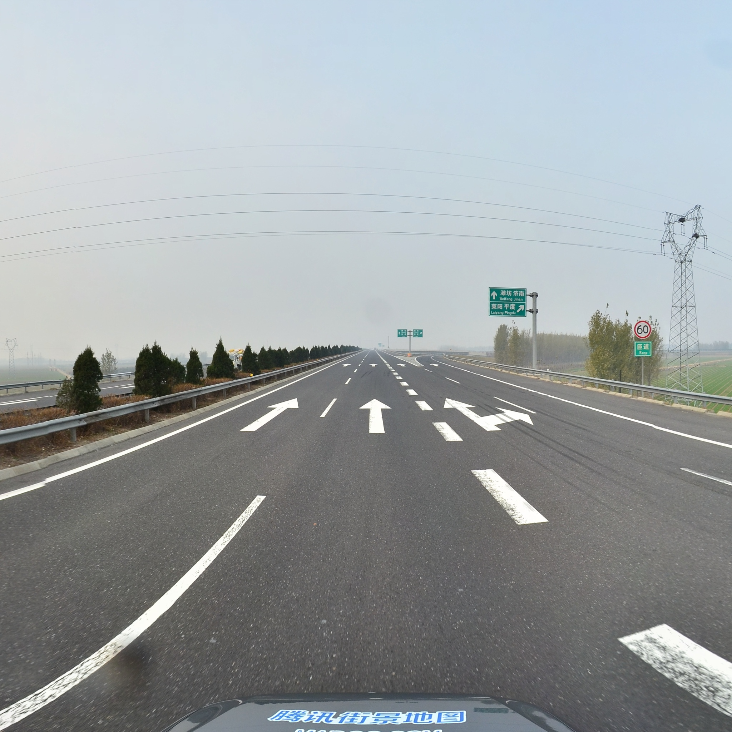
Problem Formulation
Dataset: TT1000K[1]
100,000 Tencent Street View panoramas.
30,000 containing traffic sign
Different weather conditions…
"3344": {
"path": "train/3344.jpg",
"id": 3344,
"objects": [
{
"bbox": {
"xmin": 1775.0,
"ymin": 897.0,
"xmax": 1822.0,
"ymax": 949.0
},
"category": "pl60"
}
]
},
[1]Z. Zhu, D. Liang, S. Zhang, X. Huang, B. Li, and S. Hu, “Traffic-Sign Detection and Classification in the Wild,” 2016.

Slide 6
Project Goal
State-of-the-art Model Evaluation✅
Literature review ✅
Multiple models training, evaluation and selection over multiple datasets
Improve the selected model ◻
Try to refine the best model (YOLOv8) using various methods
Compare the refined model with the original one ◻
Collect customize dataset and evaluation ✅
In-SUSTech Dataset and Wild Dataset: images + videos

Slide 7
Novelty of Our Project
State-of-the-art basic Model: YOLOv8x
Compared: Faster R-CNN,TSR-YOLO, YOLOv8n, YOLOv8x
Light-weight BECA attention mechanism refining
Similar idea from how TSR-YOLO refines YOLOv4-tiny
Extended custom datasets, as a compliment of TT1000K
Cons of TT1000K: Little data for some signs like pl15

Slide 8
02
Related Work

Slide 9
TSR-YOLO
[1] Song W, Suandi SA. TSR-YOLO: A Chinese Traffic Sign Recognition Algorithm for Intelligent Vehicles in Complex Scenes. Sensors. 2023; 23(2):749. https://doi.org/10.3390/s23020749

Slide 10
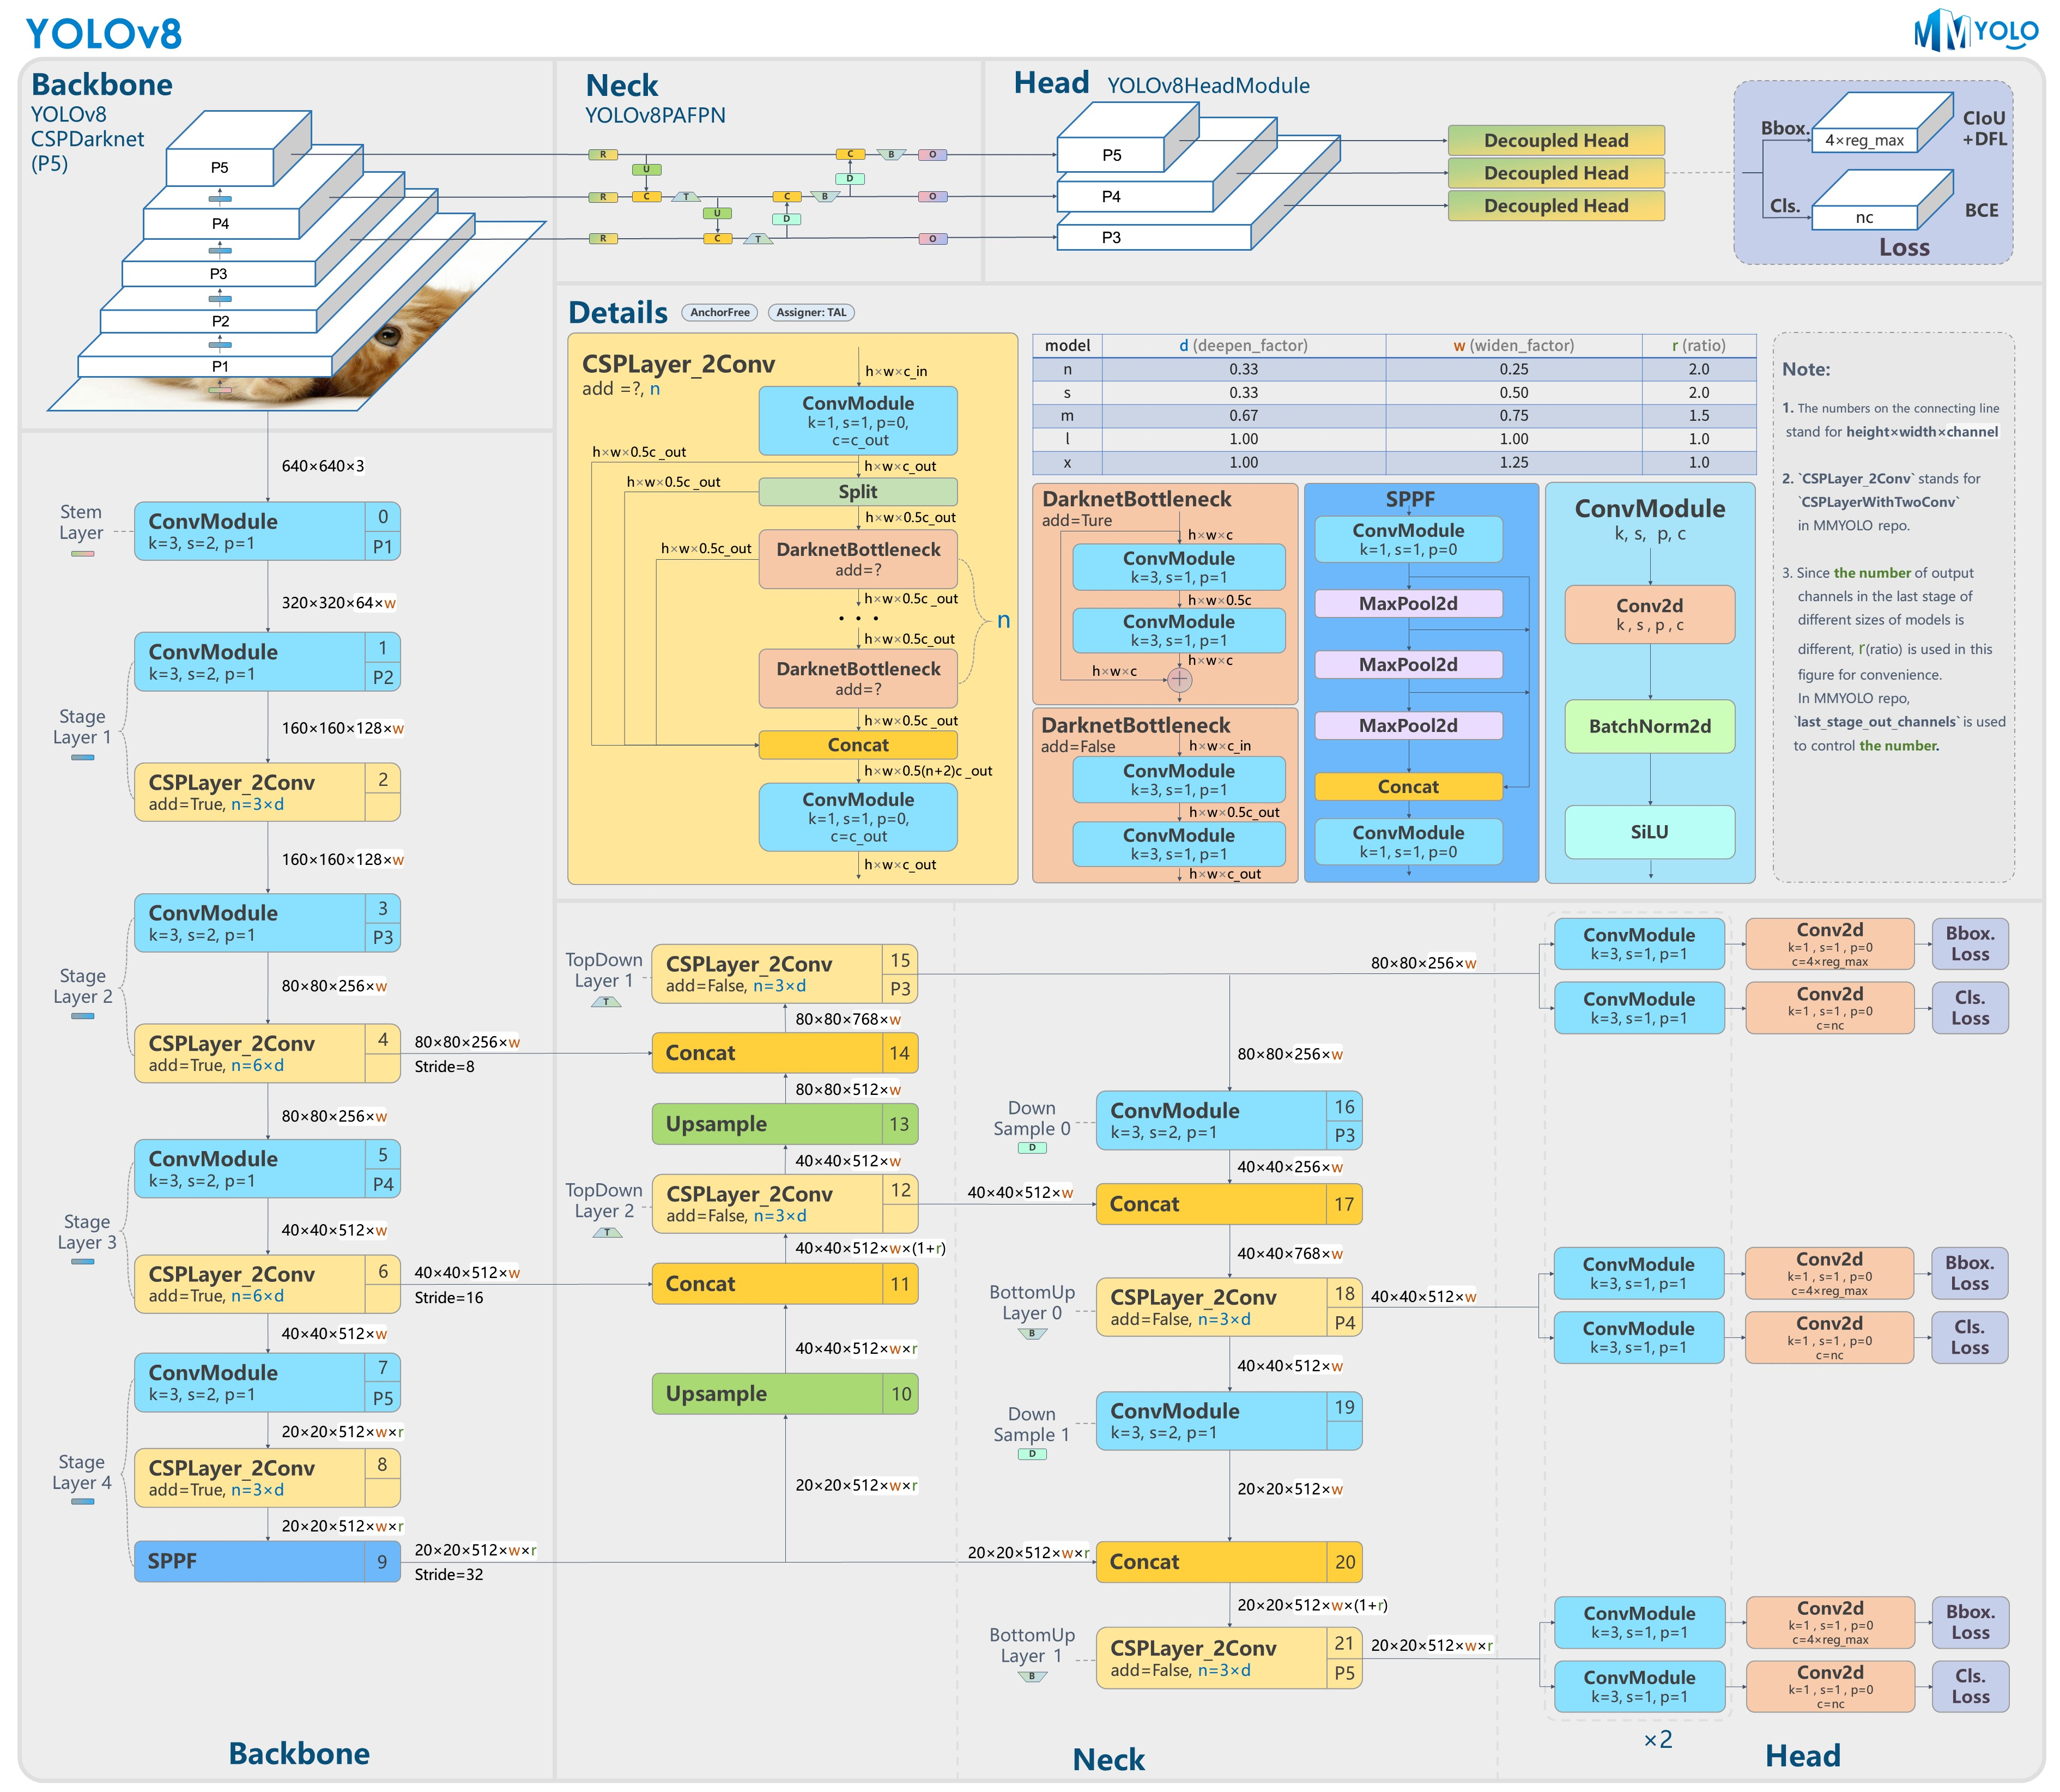
YOLOv8
[1] Song W, Suandi SA. TSR-YOLO: A Chinese Traffic Sign Recognition Algorithm for Intelligent Vehicles in Complex Scenes. Sensors. 2023; 23(2):749. https://doi.org/10.3390/s23020749

Slide 11
03
Methodology

Slide 12
Data Preprocessing
JSON-Text
"3344": {
"path": "train/3344.jpg",
"id": 3344,
"objects": [
{
"bbox": {
"xmin": 1775.0,
"ymin": 897.0,
"xmax": 1822.0,
"ymax": 949.0
},
"category": "pl60"
}
]
},
14 0.878173828125 0.45068359375 0.02294921875 0.025390625

Slide 13
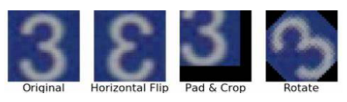
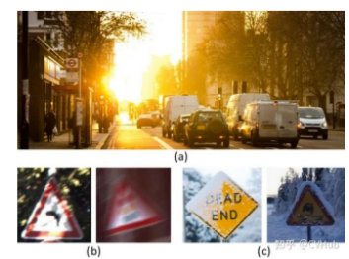
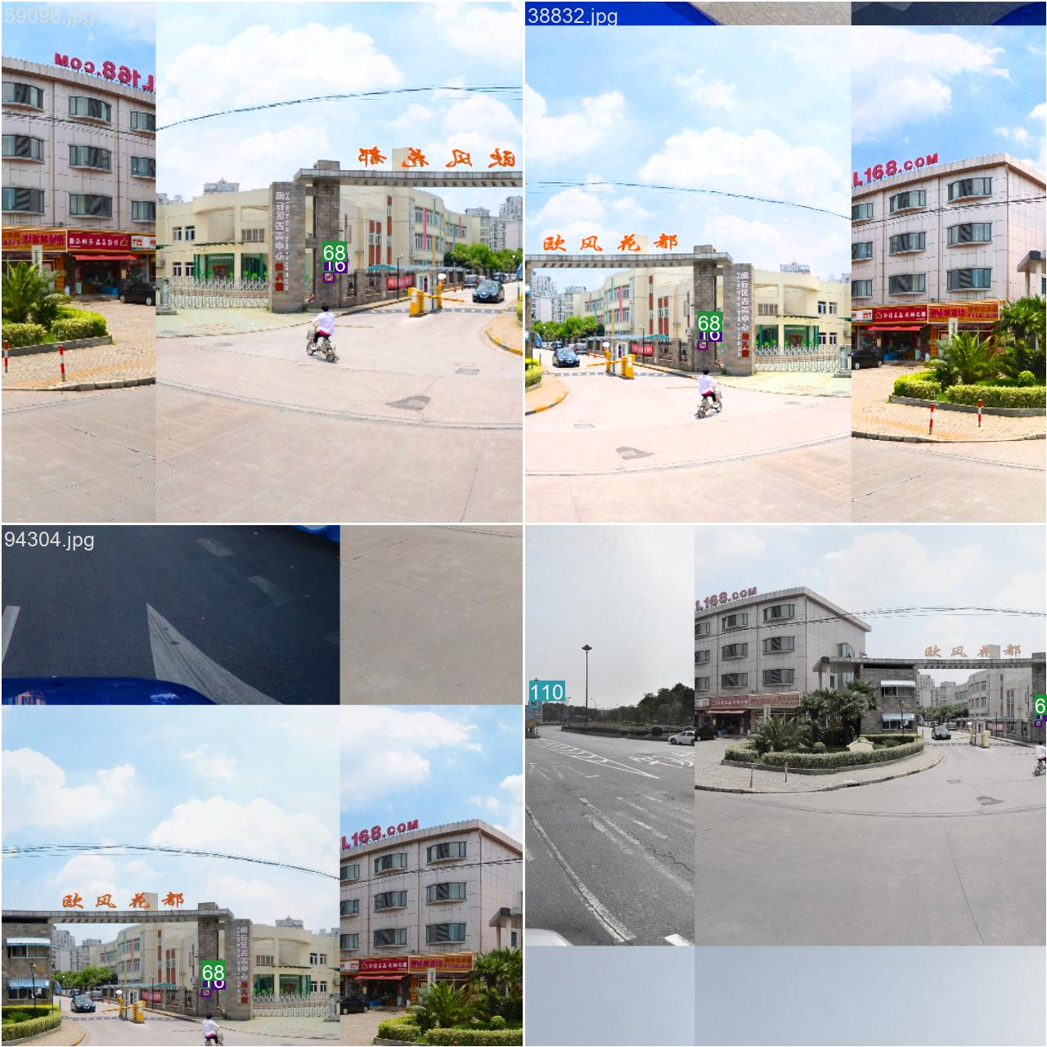
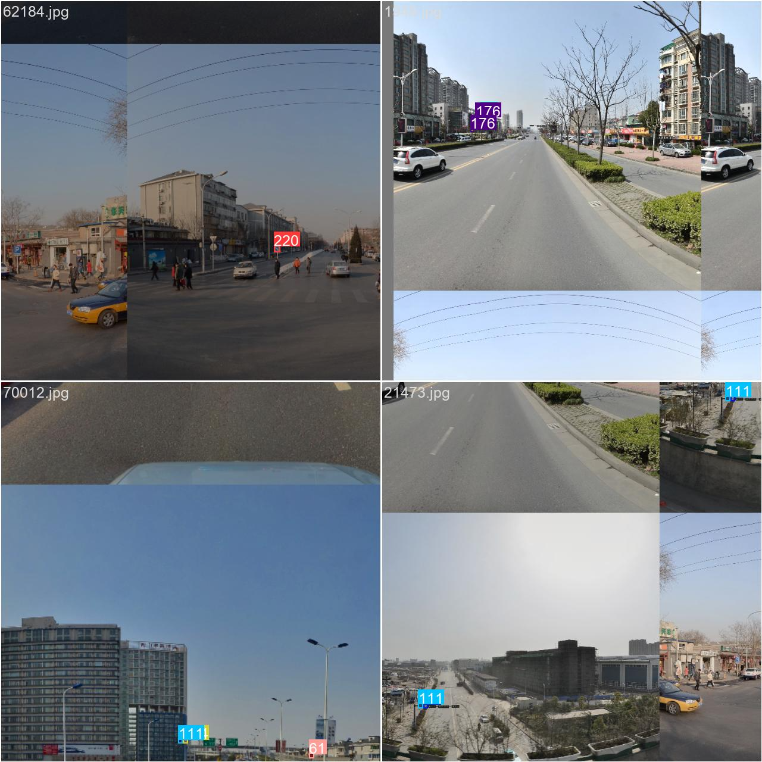
Data Preprocessing
Data Augmentation

Slide 14
Model Training
Model Selection: Faster R-CNN, TSR-YOLO, YOLOv8n, YOLOv8x
Environment:
GPULab02 Server for Teaching in Dept.CSE
Intel(R) Xeon(R) Gold 6240 CPU \@ 2.60GHz
Control the Hyper-params
[1] Song W, Suandi SA. TSR-YOLO: A Chinese Traffic Sign Recognition Algorithm for Intelligent Vehicles in Complex Scenes. Sensors. 2023; 23(2):749. https://doi.org/10.3390/s23020749

Slide 15
Model Improving
State-of-the-art basic Model: YOLOv8x
Compared: Faster R-CNN,TSR-YOLO, YOLOv8n, YOLOv8x
Light-weight BECA attention mechanism refining
Similar idea from how TSR-YOLO refines YOLOv4-tiny
Extended custom datasets, as a compliment of TT1000K
[1] Song W, Suandi SA. TSR-YOLO: A Chinese Traffic Sign Recognition Algorithm for Intelligent Vehicles in Complex Scenes. Sensors. 2023; 23(2):749. https://doi.org/10.3390/s23020749

Slide 16
04
Scheduling

Slide 17
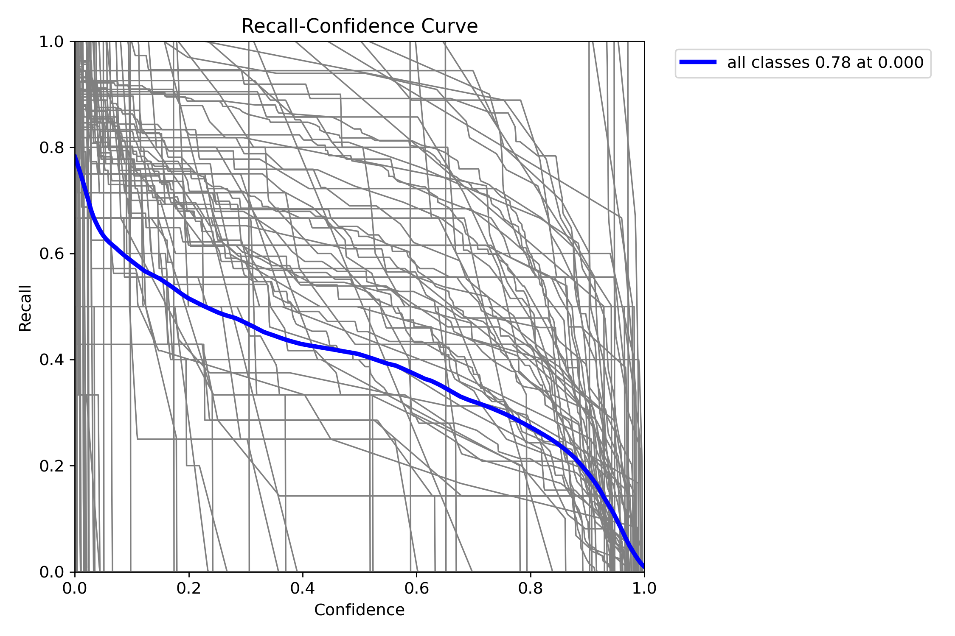
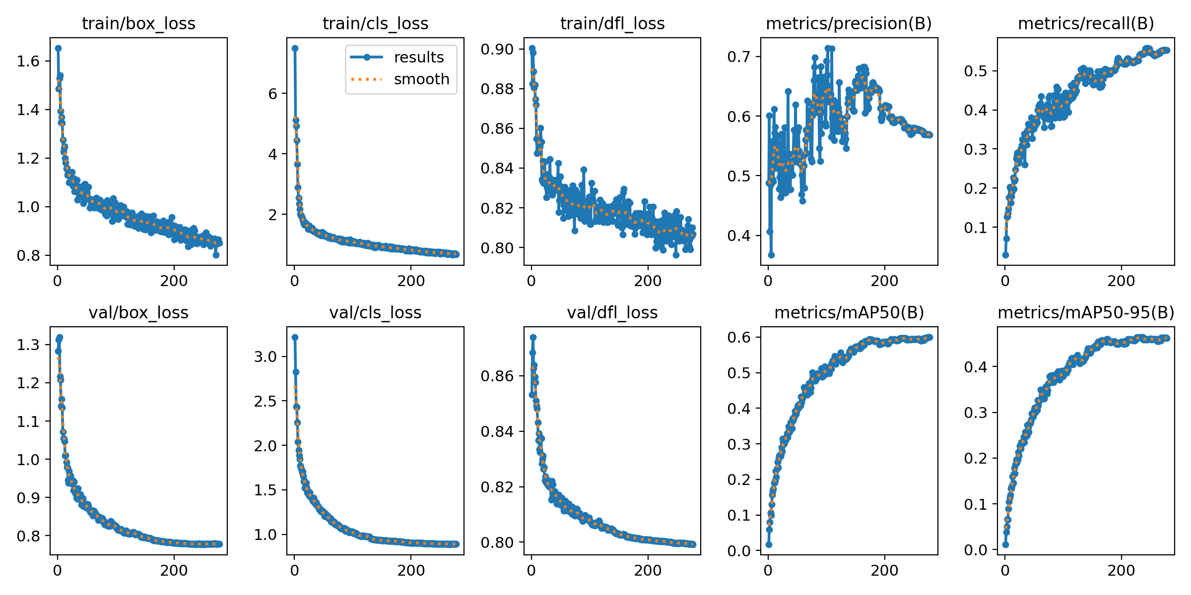
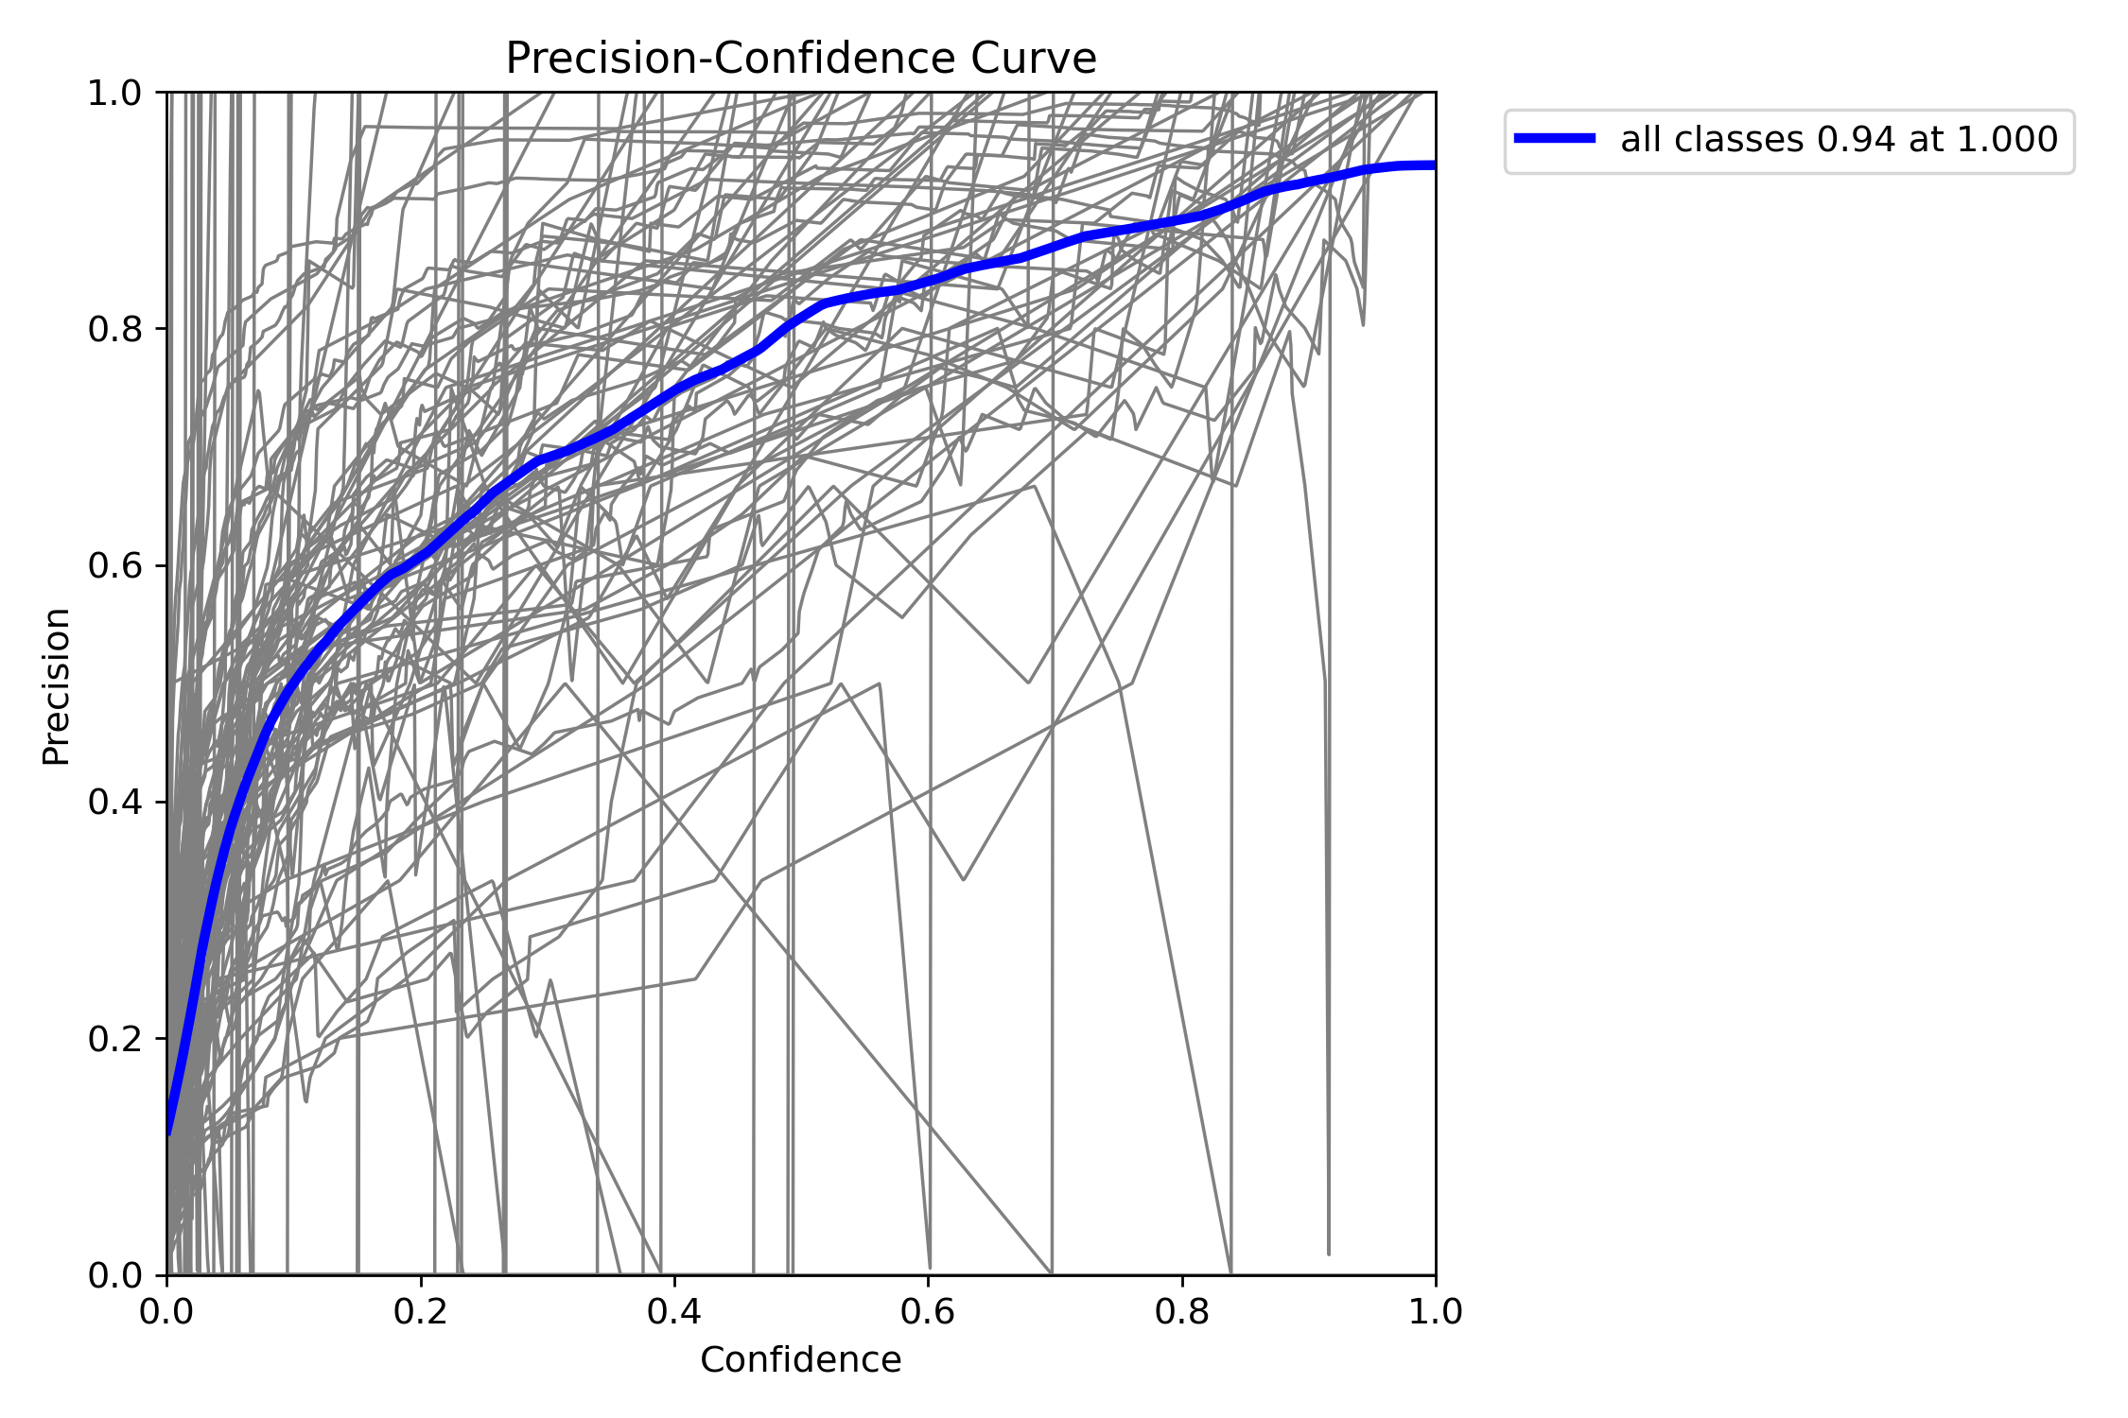
Current Progress
400-Epoch YOLOv8n/YOLOv8x

Slide 18
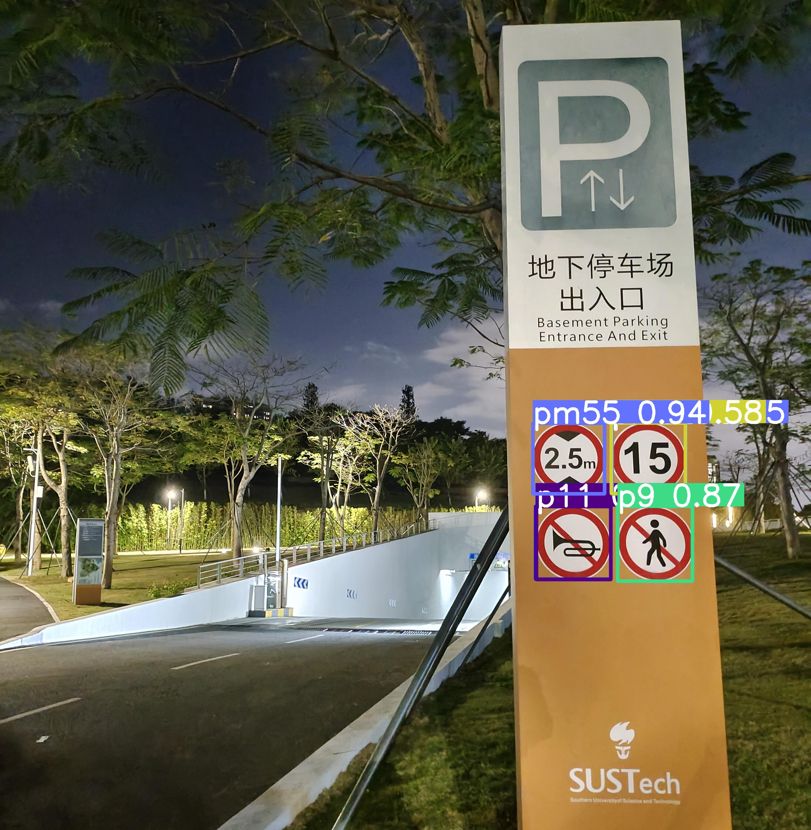
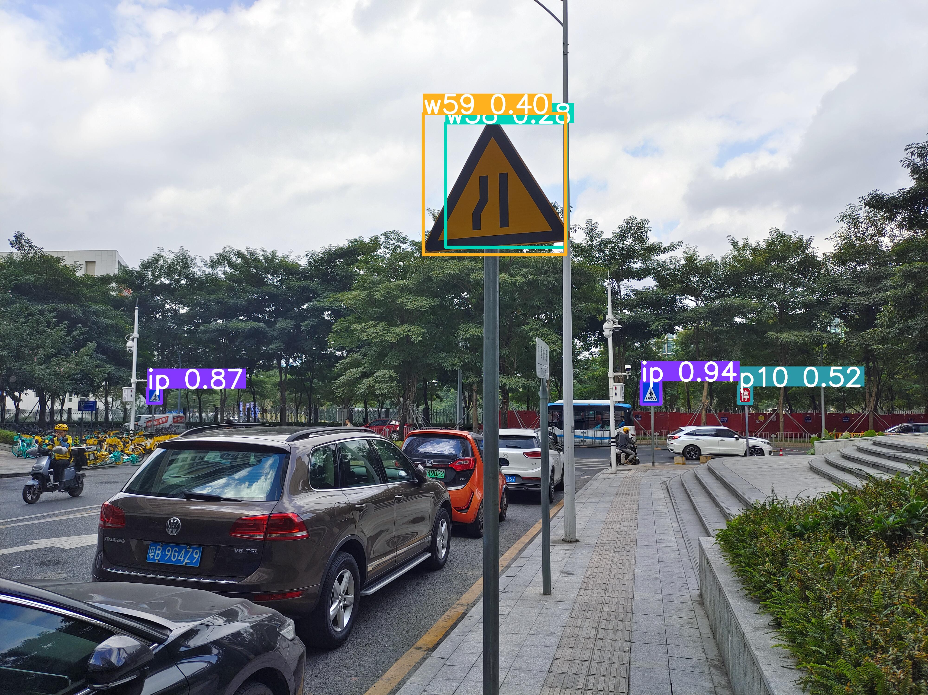
Current Progress
Custom Dataset: Image

Slide 19
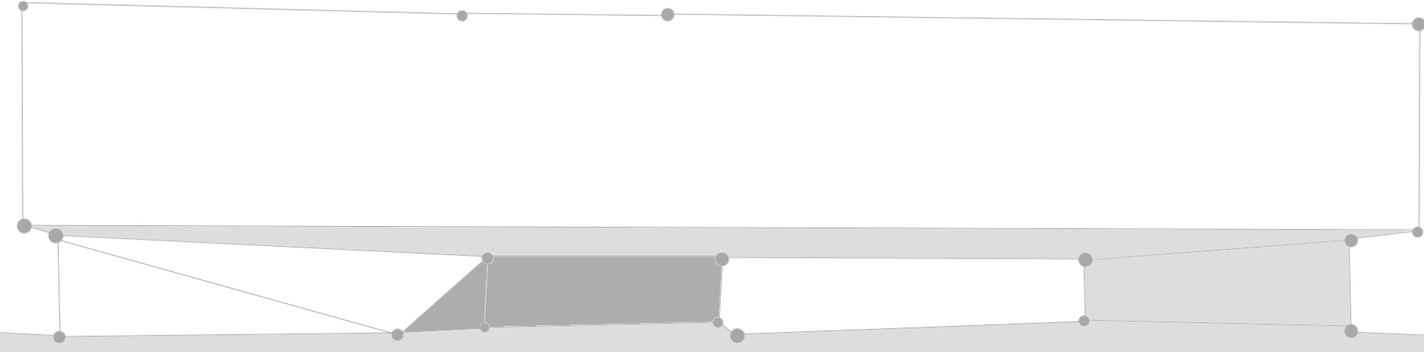

Overall Scheduling
Week 8-10
Week 11-13
Week 14-15
Further work
Project Proposal
Literature Review
Environment setup
Collect custom datasets
Evaluate over custom datasets
Summary and Conclusion
Dataset preparation
Train-validate-test
Eval-comp-select
Fine tuning the optimal model

Slide 20

Conclusion
南方科技大学（简称南科大）是深圳在中国高等教育改革发展的时代背景下，创建的一所高起点、高定位的公办创新型大学，它肩负着为我国高等教育改革发挥先导和示范作用的使命，并致力于服务创新型国家建设和深圳创新型城市建设。

Slide 21

Thank you!
点击此处输入文本，文本内容应尽量简约精炼，尽可能减少赘余的内容，并和本页呈现的主题高度相关。

Slide 22
